Slide 1






Ready Queue
CPU
(a) Single Processor Scheduling
Process A
Process Scheduler
Processor
Core 1
Process B
Unscheduled Tasks
Ready Queues
Core 2
Process C
Core 3
Thread 1
Core 4
Thread 2
(b) Many-core Scheduling
Process D
Processor 1
Processor 2
Ready Queues
Processor 3
Processor 4
(c) Multi-processor Scheduling

Slide 2



Storage Devices
Application1 Request
I/O Scheduler
Application2 Request
Add Request
Dispatch
Application3 Request
…
I/O Scheduling

Slide 3
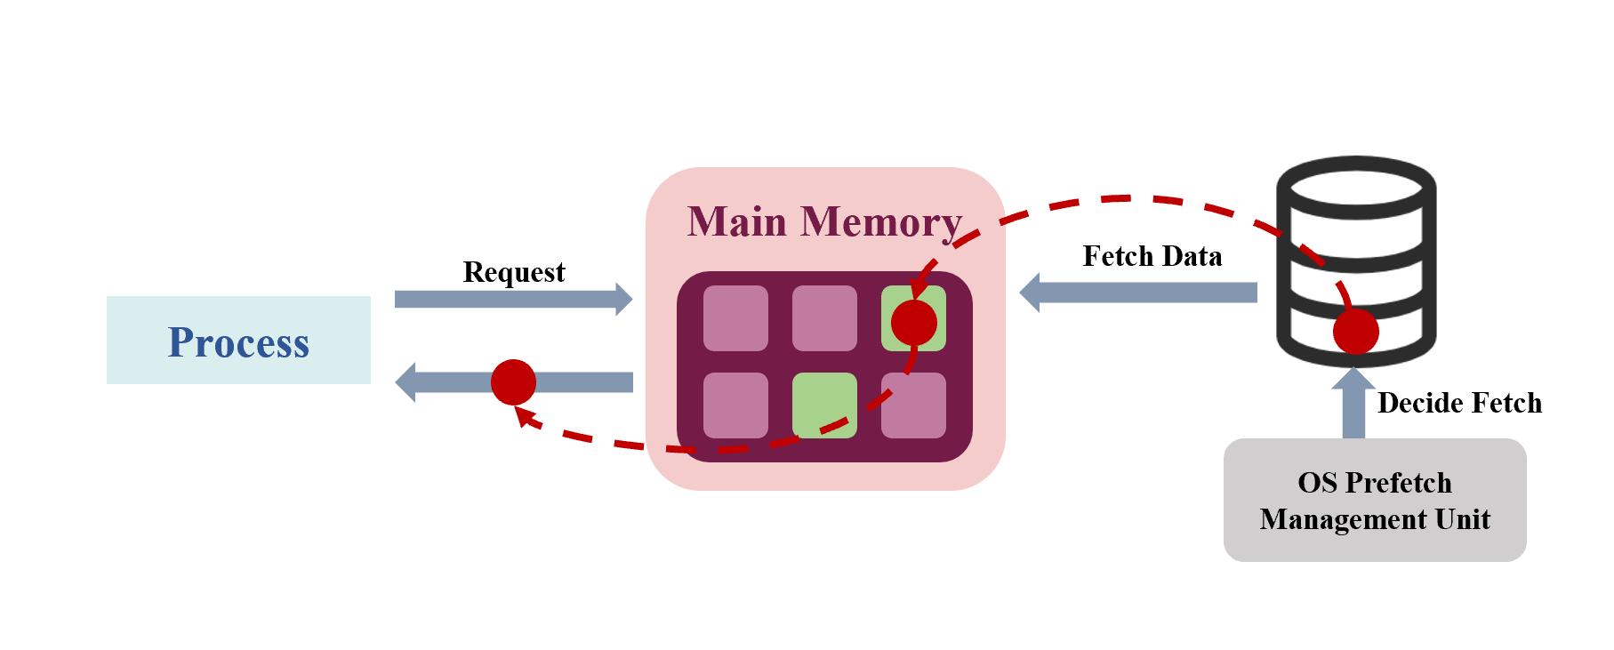
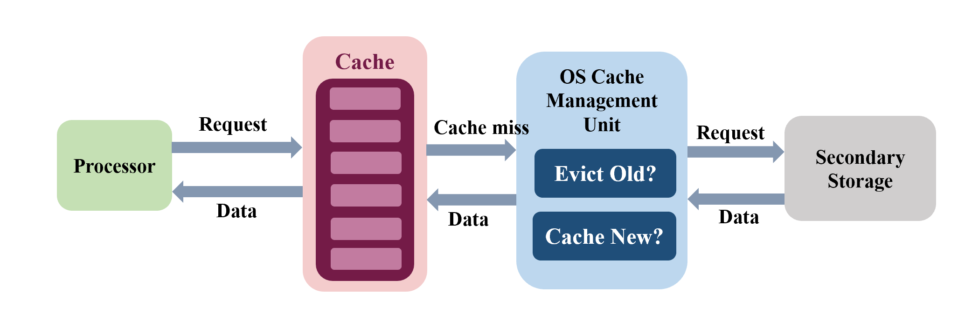
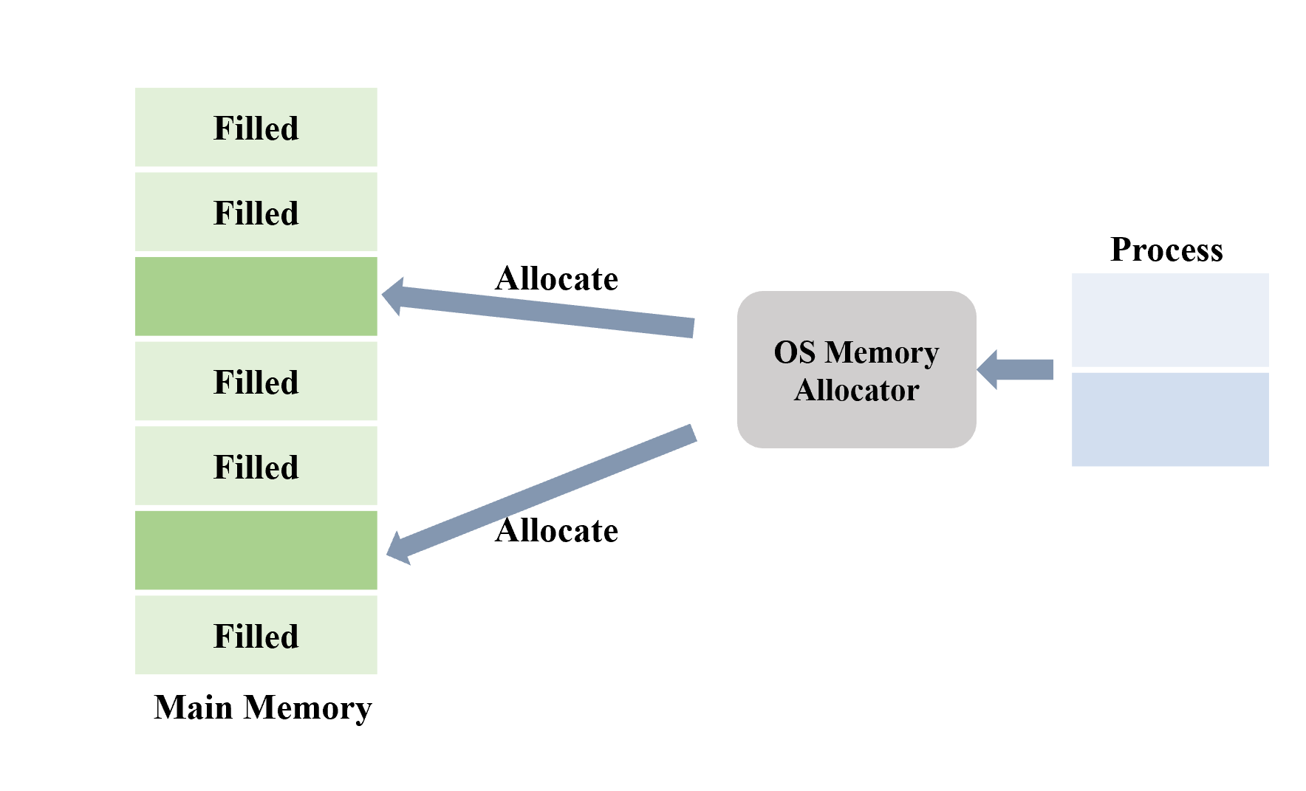
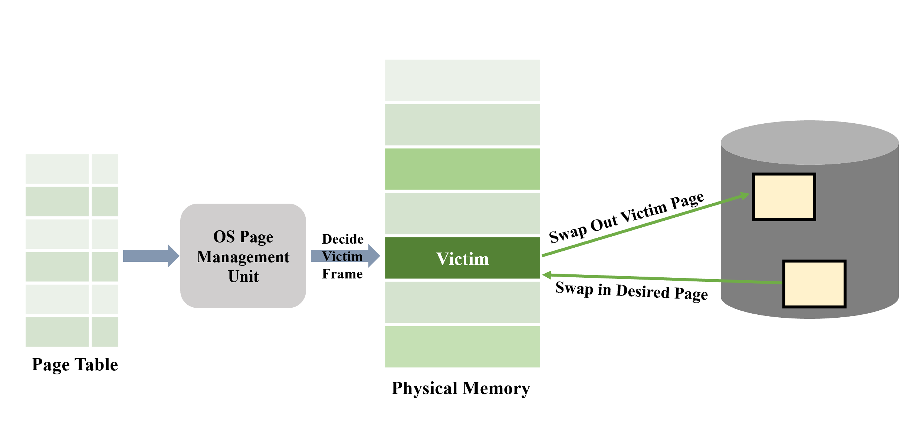
(a) Cache Management
(b) Prefetch Mechanism
(c) Page Replacement
(d) Space Allocation

Slide 4
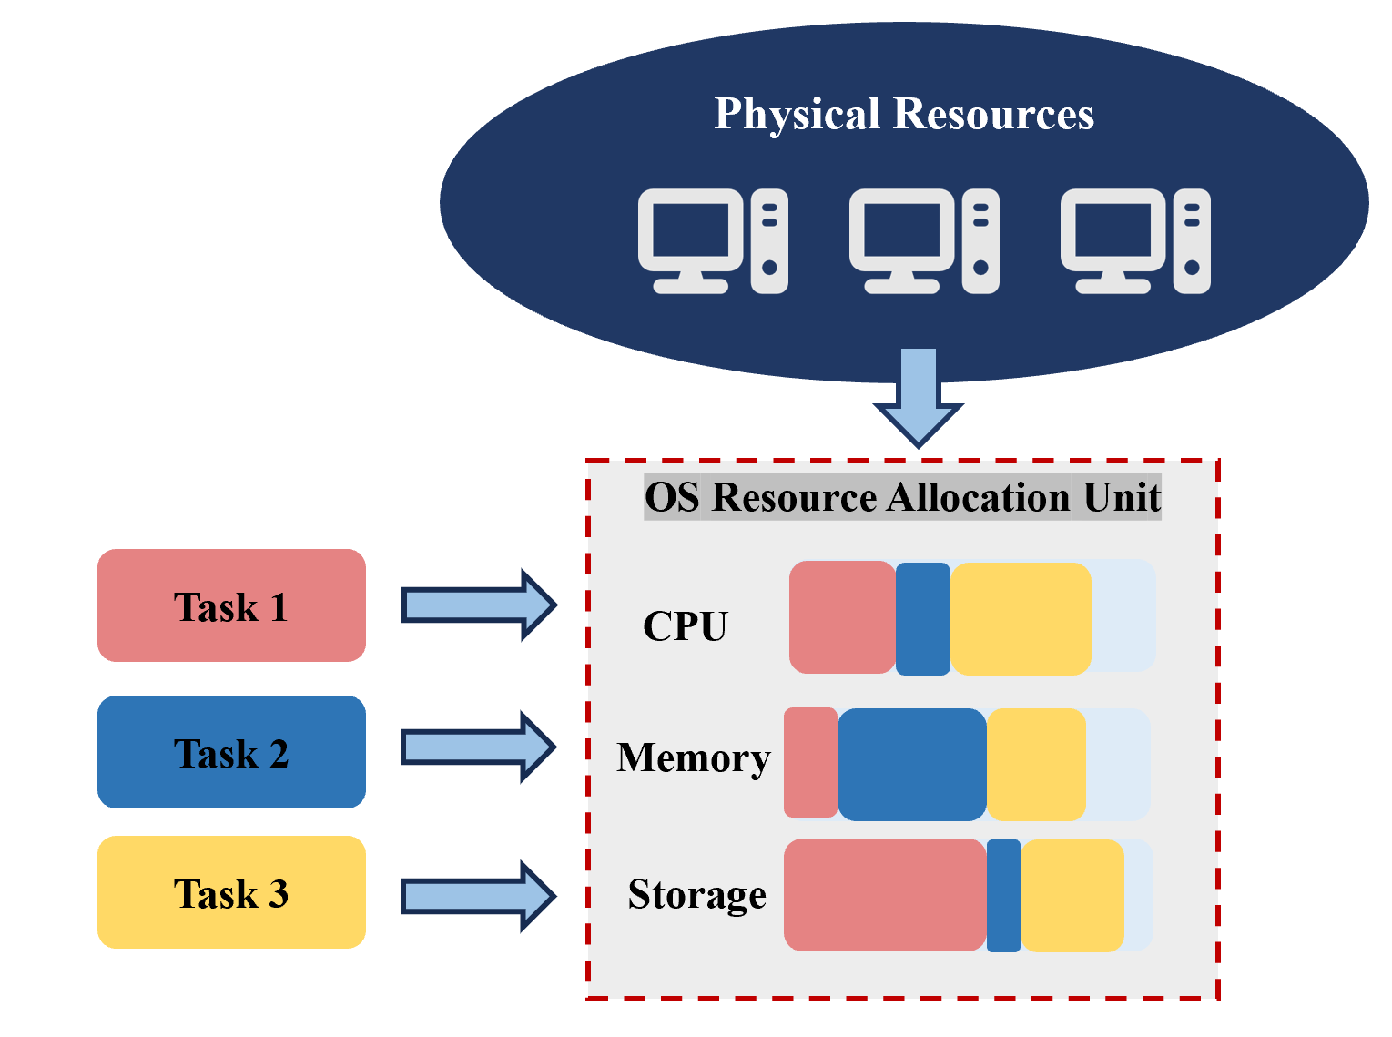
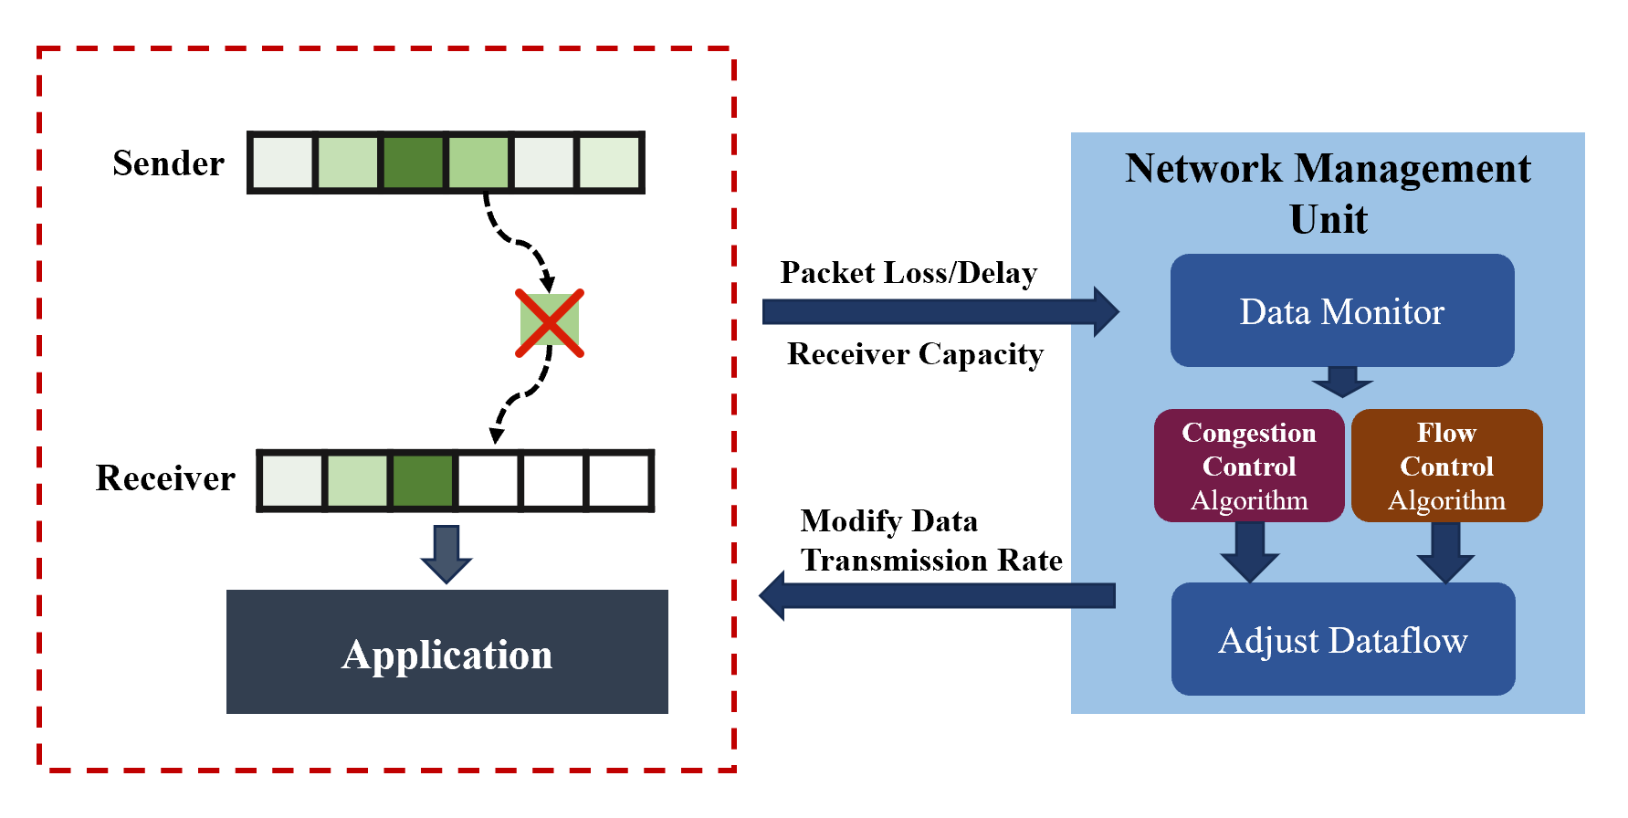
(a) Congestion Control & Flow Control
(b) Resource Allocation

Slide 5
Unscheduled Processes
Process Scheduler
Ready Queue
CPU

Slide 6
Process A
Core 1
Process Scheduler
Process B
Core 2
Process C
Core 3
Thread 1
Thread 2
Core 4
Process D

Slide 7
Processor
Core 1
Process Scheduler
Core 2
Unscheduled Tasks
Core 3
Core 4

Slide 8
Cache
OS Cache Management Unit
Request
Cache miss
Request
Processor
Secondary Storage
Evict Old?
Data
Data
Data
Cache New?

Slide 9
Main Memory
Request
Fetch Data
Process
Decide Fetch
OS Prefetch Management Unit

Slide 10
Victim
OS Page Management Unit
Swap Out Victim Page
Decide Victim Frame
Swap in Desired Page
Page Table
Physical Memory

Slide 11
Filled
Filled
Filled
Filled
Filled
Process
Allocate
OS Memory Allocator
Allocate
Main Memory

Slide 12

Sender
Network Management Unit
Packet Loss/Delay
Data Monitor
Receiver Capacity
Congestion Control Algorithm
Flow Control Algorithm
Receiver
Modify Data Transmission Rate
Application
Adjust Dataflow

Slide 13

Physical Resources
OS Resource Allocation Unit
Task 1
CPU
Task 2
Memory
Task 3
Storage

